Slide 1
Designing with Layouts

Slide 2
Overview
Create user interfaces in Android by defining resource files or through programming
Organize your user interface using layout classes of View container controls
Use built-in layout classes such as FrameLayout, LinearLayout, TableLayout, and GridLayout
Use container control classes for lists, grids, scrolling, and switching

Slide 3
Creating User Interfaces in Android
Application user interfaces can be simple or complex, involving many different screens or only a few
Layouts and user interface controls can be defined as application resources or created programmatically at runtime
The term layout is used for two different but related purposes in Android user interface design
  For resources, the /res/layout directory contains XML resource definitions often called layout resource files
    These XML files provide templates for how to draw controls on the screen
    Layout resource files may contain any number of controls
  The term layout is also used to refer to a set of ViewGroup classes, such as LinearLayout, FrameLayout, TableLayout, RelativeLayout, and GridLayout
    These controls are used to organize other View controls

Slide 4
Creating Layouts Using XML Resources
    <?xml version="1.0" encoding="utf-8"?>
    <LinearLayout xmlns:android=
    "http://schemas.android.com/apk/res/android"
    android:orientation="vertical"
    android:layout_width="match_parent"
    android:layout_height="match_parent" >
    <TextView
    android:layout_width="match_parent"
    android:layout_height="wrap_content"
    android:text="@string/hello" />
    </LinearLayout>
Notes:
Android provides a simple way to create layout resource files in XML. These resources are stored in the /res/layout project directory hierarchy. This is the most common and convenient way to build Android user interfaces and is especially useful for defining screen elements and default control properties that you know about at compile time. These layout resources are then used much like templates. They are loaded with default attributes that you can modify programmatically at runtime.
You can configure almost any ViewGroup or View (or View subclass) attribute using the XML layout resource files. This method greatly simplifies the user interface design process, moving much of the static creation and layout of user interface controls, and basic definition of control attributes, to the XML instead of littering the code. Developers reserve the ability to alter these layouts programmatically as necessary, but they can set all the defaults in the XML template.
You’ll recognize this example as a simple layout file with a LinearLayout and a single TextView control. Here is the default layout file provided with any new Android project in the Android IDE, referred to as /res/layout/activity_main.xml.
This block of XML shows a basic layout with a single TextView control. The first line, which you might recognize from most XML files, is required with the android layout namespace, as shown. Because it’s common across all the files, we do not show it in any other examples.
Next, we have the LinearLayout element. LinearLayout is a ViewGroup that shows each child View either in a single column or in a single row. When applied to a full screen, it merely means that each child View is drawn under the previous View if the orientation is set to vertical or to the right of the previous View if the orientation is set to horizontal.
Finally, there is a single child View—in this case, a TextView. A TextView is a control that is also a View. A TextView draws text on the screen. In this case, it draws the text defined in the "@string/hello" string resource.

Slide 5
Creating Layouts Using XML Resources
setContentView(R.layout.activity_main);
Notes:
Creating only an XML file, though, won’t actually draw anything on the screen. A particular layout is usually associated with a particular Activity. In your default Android project, there is only one Activity, which sets the activity_main.xml layout by default. To associate the activity_main.xml layout with the Activity, use the method call setContentView() with the identifier of the activity_main.xml layout. The ID of the layout matches the XML filename without the extension. In this case, the preceding example came from activity_main.xml, so the identifier of this layout is simply activity_main.

Slide 6
Creating Layouts Programmatically
    public void onCreate(Bundle savedInstanceState) {
    super.onCreate(savedInstanceState);
    TextView text1 = new TextView(this);
    text1.setText(R.string.string1);
    TextView text2 = new TextView(this);
    text2.setText(R.string.string2);
    text2.setTextSize(TypedValue.COMPLEX_UNIT_SP, 60);
    LinearLayout ll = new LinearLayout(this);
    ll.setOrientation(LinearLayout.VERTICAL);
    ll.addView(text1);
    ll.addView(text2);
    setContentView(ll);
    }
Notes:
You can create user interface components such as layouts at runtime programmatically, but for organization and maintainability, it’s best that you leave this for the odd case rather than the norm. The main reason is that the creation of layouts programmatically is onerous and difficult to maintain, whereas the XML resources are visual, more organized, and could be used by a separate designer with no Java skills.
The example we see here shows how to programmatically have an Activity instantiate a LinearLayout and place two TextView controls within it as child controls. The same two string resources are used for the contents of the controls; these actions are done at runtime instead.
The onCreate() method is called when the Activity is created. The first thing this method does is some normal housekeeping by calling the constructor for the base class.
Next, two TextView controls are instantiated. The Text property of each TextView is set using the setText() method. All TextView attributes, such as TextSize, are set by making method calls on the TextView control. These actions perform the same function of setting the properties Text and TextSize as when using the Android IDE layout resource designer, except these properties are set at runtime instead of defined in the layout files compiled into your application package.
To display the TextView controls appropriately, we need to encapsulate them within a container of some sort (a layout). In this case, we use a LinearLayout with the orientation set to VERTICAL so that the second TextView begins beneath the first, each aligned to the left of the screen. The two TextView controls are added to the LinearLayout in the order we want them to display.
Finally, we call the setContentView() method, part of the Activity class, to draw the LinearLayout and its contents on the screen.
As you can see, the code can rapidly grow in size as you add more View controls and you need more attributes for each View.

Slide 7
Creating Layouts Programmatically
  <?xml version="1.0" encoding="utf-8"?>
  <LinearLayout xmlns:android="http://schemas.android.com/apk/res/android"
  android:orientation="vertical"
  android:layout_width="match_parent"
  android:layout_height="match_parent">
  <TextView android:id="@+id/TextView1"
  android:layout_width="match_parent"
  android:layout_height="wrap_content"
  android:text="@string/string1" />
  <TextView android:id="@+id/TextView2"
  android:layout_width="match_parent"
  android:layout_height="wrap_content"
  android:textSize="60sp"
  android:text="@string/string2" />
  </LinearLayout>
Notes:
Here is that same layout, now in an XML layout file.
First, in the XML layout files, layout_width and layout_height are required attributes. Next, you see that each TextView control has a unique id property assigned so that it can be accessed programmatically at runtime. Finally, the textSize property needs to have its units defined. The XML attribute takes a dimension type.
The end result differs only slightly from the programmatic method. However, it’s far easier to read and maintain.

Slide 8
Creating Layouts Programmatically
The layout resource is stored in the /res/layout/resource_based_layout.xml file:
    setContentView(R.layout.resource_based_layout);
Notes:
Now you need only one line of code to display this layout view.

Slide 9
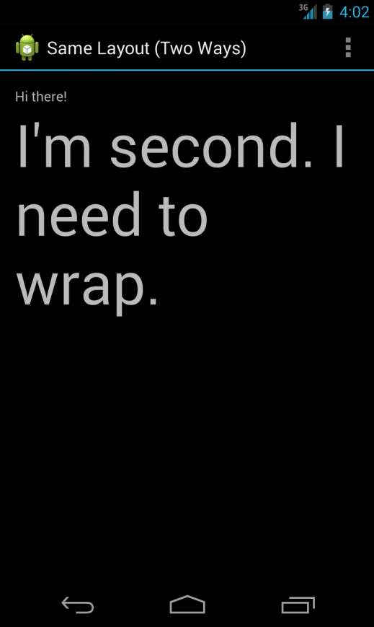
Creating Layouts Programmatically
Notes:
You might have noticed that these are not literal translations of each other, although the output is identical, as shown here.

Slide 10
Organizing Your User Interface
All user interface controls, such as Button, Spinner, and EditText, derive from the View class
In Android, there is a special kind of View called a ViewGroup
ViewGroup subclasses are broken down into two categories:
  Layout classes
  View container controls
Notes:
The classes derived from ViewGroup enable developers to display View controls such as TextView and Button controls on the screen in an organized fashion.
It’s important to understand the difference between View and ViewGroup. Like other View controls, including the controls from the previous chapter, ViewGroup controls represent a rectangle of screen space. What makes ViewGroup different from a typical control is that ViewGroup objects contain other View controls. A View that contains other View controls is called a parent View.
The parent View contains View controls called child views, or children.
You add child View controls to a ViewGroup programmatically using the method addView(). In XML, you add child objects to a ViewGroup by defining the child View control as a child node in the XML (within the parent XML element, as we’ve seen various times using the LinearLayout ViewGroup).

Slide 11
Using ViewGroup Subclasses for Layout Design
Many of the most important subclasses of ViewGroup used for screen design end with “Layout”
The most common layout classes are LinearLayout, RelativeLayout, TableLayout, FrameLayout , and GridLayout
You can use each of these classes to position other View controls on the screen in different ways
We’ve been using the LinearLayout to arrange various TextView and EditText controls on the screen in a single vertical column
Users do not generally interact with the layouts directly
Instead, they interact with the View controls they contain

Slide 12
Using ViewGroup Subclasses as View Containers
The second category of ViewGroup subclasses is the indirect “ subclasses”
These special View controls act as View containers just as Layout objects do, but they also provide some kind of active functionality that enables users to interact with them like other controls
Unfortunately, these classes are not known by any handy names
Instead, they are named for the kind of functionality they provide
Some of the classes that fall into this category include
  GridView
  ImageSwitcher
  ScrollView
  ListView
It can be helpful to consider these objects as different kinds of View browsers, or container classes
A ListView displays each View control as a list item, and the user can browse between the individual controls using vertical scrolling capability

Slide 13
Using Built-in Layout Classes
The types of layouts built into the Android SDK framework include
  LinearLayout
  RelativeLayout
  FrameLayout
  TableLayout
  GridLayout
These layouts are derived from
  android.view.ViewGroup
Notes:
We talked a lot about the LinearLayout layout, but there are several other types of layouts. Each layout has a different purpose and order in which it displays its child View controls on the screen.

Slide 14
Using Built-in Layout Classes
    android:layout_attribute_name="value"
Notes:
All layouts, regardless of their type, have basic layout attributes. Layout attributes apply to any child View control within that layout. You can set layout attributes at runtime programmatically, but ideally you set them in the XML layout files using the syntax shown here.

Slide 15
Using Built-in Layout Classes
There are several layout attributes that all ViewGroup objects share
These include size attributes and margin attributes
  Find these basic layout attributes in the ViewGroup.LayoutParams class
The margin attributes enable each child View within a layout to have padding on each side
  Find these attributes in the ViewGroup.MarginLayoutParams classes
There are also a number of ViewGroup attributes for handling child View drawing bounds and animation settings

Slide 16
Using Built-in Layout Classes
Attribute Name | Applies to | Value
layout_height | Parent or child View | Dimension value or match_parent or wrap_content
layout_width | Parent or child View | Dimension value or match_parent or wrap_content
layout_margin | Parent or child View | Dimension value or match_parent or wrap_content
Notes:
Some of the important attributes shared by all ViewGroup subtypes are as follows:
layout_height
The height of the view. It is used as an attribute for child View controls within layouts. This is required in some layouts, optional in others.
layout_width
The width of the view. It is used as an attribute for child View controls within layouts. This is required in some layouts, optional in others.
layout_margin
The extra space around all sides of a View.

Slide 17
Using Built-in Layout Classes
<LinearLayout xmlns:android=
"http://schemas.android.com/apk/res/android"
android:layout_width="match_parent"
android:layout_height="match_parent">
<TextView
android:id="@+id/TextView01"
android:layout_height="match_parent"
android:layout_width="match_parent" />
</LinearLayout>
Notes:
Here’s an XML layout resource example of a LinearLayout set to the size of the screen, containing one TextView that is set to its full height and the width of the LinearLayout (and therefore the screen).

Slide 18
Using Built-in Layout Classes
<Button
android:id="@+id/Button01"
android:layout_width="wrap_content"
android:layout_height="wrap_content"
android:text="Press Me"
android:layout_marginRight="20dp"
android:layout_marginTop="60dp" />
Notes:
Here is an example of a Button object with some margins set via XML used in a layout resource file.

Slide 19
Using Built-in Layout Classes
A layout element can cover any rectangular space on the screen
  It doesn’t need to fill the entire screen
Layouts can be nested within one another
  This provides great flexibility when developers need to organize screen elements
It is common to start with a FrameLayout or LinearLayout as the parent layout for the entire screen and then organize individual screen elements inside the parent layout using whichever layout type is most appropriate

Slide 20
Using LinearLayout
A LinearLayout view organizes its child View controls in a single row, or a single column, depending on whether its orientation attribute is set to horizontal or vertical
This is a very handy layout method for creating forms
You can find the layout attributes available for LinearLayout child View controls in android.widget.LinearLayout.LayoutParams

Slide 21
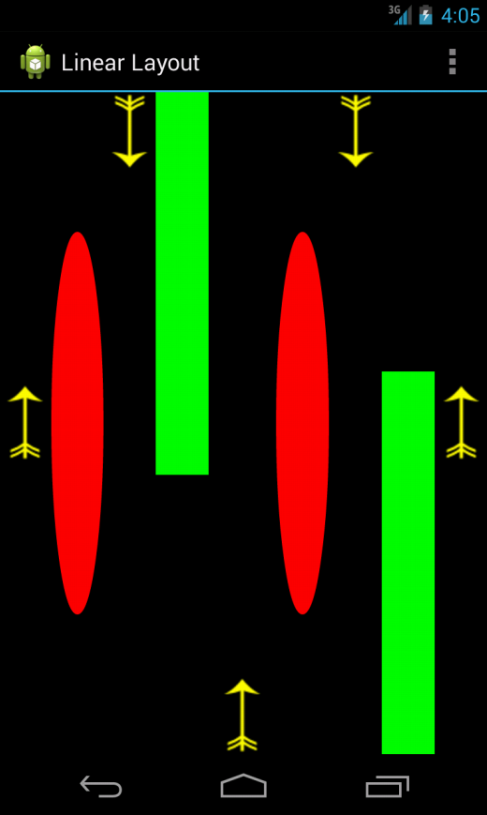
Using LinearLayout
Notes:
Here is an example of a LinearLayout.

Slide 22
Using LinearLayout
Attribute Name | Applies to | Value
orientation | Parent View | Either horizontal or vertical
gravity | Parent View | One or more constants separated by “|” such as top, bottom, left, right, and many others
weightSum | Parent View | A number that defines the sum of all child control weights; default is 1
layout_gravity | Child View | One or more constants separated by “|” such as top, bottom, left, right, and many others
layout_weight | Child View | The sum of values across all child views in a parent View must equal the weightSum attribute of the parent LinearLayout control, e.g., .3 or .7
Notes:
This table describes some of the important attributes specific to LinearLayout views.
orientation
Single row (horizontal) or single column (vertical) of controls.
gravity
For child views within the layout.
weightSum
The sum of all child control weights.
layout_gravity
The gravity for a specific child View. Used for positioning of views.
layout_weight
The weight for a specific child View. Used to provide the ratio of screen space used within the parent control.

Slide 23
Using RelativeLayout
The RelativeLayout view enables you to specify where the child View controls are in relation to each other
  For instance, you can set a child View to be positioned “above” or “below” or “to the left of” or “to the right of” another View
  You can also align child View controls relative to one another or the parent layout edges
Combining RelativeLayout attributes can simplify creating interesting user interfaces without resorting to multiple layout groups to achieve a desired effect

Slide 24
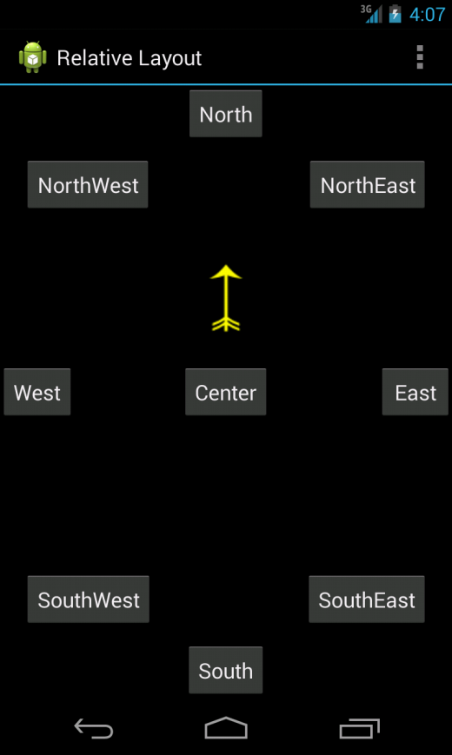
Using RelativeLayout
Notes:
This figure shows where the Button controls are relative to each other.

Slide 25
Using RelativeLayout
You can find the layout attributes available for RelativeLayout child View controls in android.widget.RelativeLayout.LayoutParams

Slide 26
Using RelativeLayout
Attribute Name | Applies to | Value
gravity | Parent View | One or more constants separated by “|” such as top, bottom, left, right, and more
layout_centerInParent | Child View | True or false
layout_centerHorizontal | Child View | True or false
layout_centerVertical | Child View | True or false
layout_alignParentTop | Child View | True or false
layout_alignParentBottom | Child View | True or false
layout_alignParentLeft | Child View | True or false
layout_alignParentRight | Child View | True or false
Notes:
This table describes some of the important attributes specific to RelativeLayout views.

Slide 27
Using RelativeLayout
Attribute Name | Applies To | Value
layout_alignRight | Child View | A View ID; e.g., @id/Button1
layout_alignLeft | Child View | A View ID; e.g., @id/Button1
layout_alignTop | Child View | A View ID; e.g., @id/Button1
layout_alignBottom | Child View | A View ID; e.g., @id/Button1
layout_above | Child View | A View ID; e.g., @id/Button1
layout_below | Child View | A View ID; e.g., @id/Button1
layout_toLeftOf | Child View | A View ID; e.g., @id/Button1
layout_toRightOf | Child View | A View ID; e.g., @id/Button1

Slide 28
Using RelativeLayout
  <RelativeLayout xmlns:android="http://schemas.android.com/apk/res/android"
  android:id="@+id/RelativeLayout01"
  android:layout_height="match_parent"
  android:layout_width="match_parent">
  <Button android:id="@+id/ButtonCenter"
  android:text="Center" android:layout_width="wrap_content"
  android:layout_height="wrap_content"
  android:layout_centerInParent="true" />
  <ImageView android:id="@+id/ImageView01"
  android:layout_width="wrap_content"
  android:layout_height="wrap_content"
  android:layout_above="@id/ButtonCenter"
  android:layout_centerHorizontal="true"
  android:src="@drawable/arrow" />
  </RelativeLayout>
Notes:
Here’s an example of an XML layout resource with a RelativeLayout and two child View controls—a Button object aligned relative to its parent, and an ImageView aligned and positioned relative to the Button (and the parent).

Slide 29
Using FrameLayout
A FrameLayout view is designed to display a stack of child View items
You can add multiple views to this layout, but each View is drawn from the top-left corner of the layout
You can find the layout attributes available for FrameLayout child View controls in android.widget.FrameLayout.LayoutParams

Slide 30
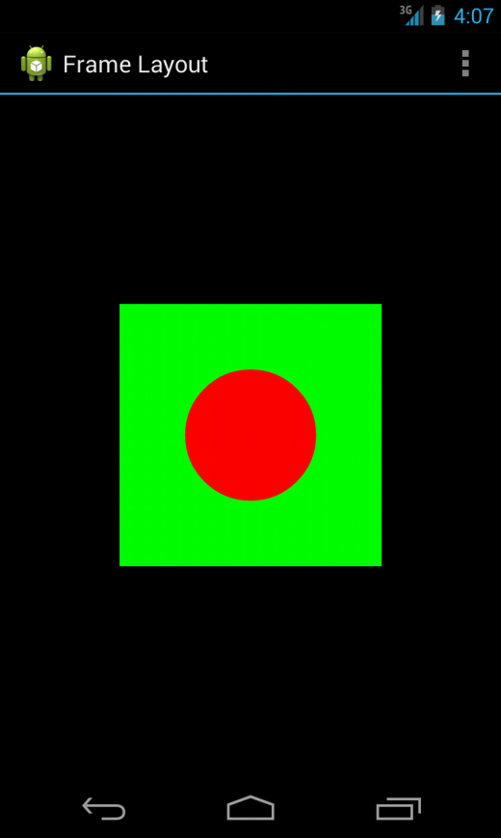
Using FrameLayout
Notes:
You can use FrameLayout to show multiple images within the same region, as shown here; the layout is sized to the largest child View in the stack.

Slide 31
Using FrameLayout
Attribute Name | Applies to | Value
foreground | Parent View | Drawable resource
foregroundGravity | Parent View | One or more constants separated by “|” such as top, bottom, left, right, and many others
measureAllChildren | Parent View | True or false
layout_gravity | Child View | One or more constants separated by “|” such as top, bottom, left, right, and many others
Notes:
foreground
A drawable to draw over the content.
foregroundGravity
The gravity of a foreground drawable.
measureAllChildren
Restricts the size of the layout to all child views or just the child views set to VISIBLE (and not those set to INVISIBLE).
layout_gravity
A gravity constant that describes the child View within the parent.

Slide 32
Using FrameLayout
  <FrameLayout xmlns:android="http://schemas.android.com/apk/res/android"
  android:id="@+id/FrameLayout01"
  android:layout_width="wrap_content"
  android:layout_height="wrap_content"
  android:layout_gravity="center">
  <ImageView android:id="@+id/ImageView01"
  android:layout_width="wrap_content"
  android:layout_height="wrap_content"
  android:src="@drawable/green_rect"
  android:contentDescription="@string/green_rect"
  android:minHeight="200dp" android:minWidth="200dp" />
  <ImageView android:id="@+id/ImageView02"
  android:layout_width="wrap_content"
  android:layout_height="wrap_content"
  android:src="@drawable/red_oval"
  android:contentDescription="@string/red_oval"
  android:minHeight="100dp" android:minWidth="100dp"
  android:layout_gravity="center" />
  </FrameLayout>
Notes:
Here’s an example of an XML layout resource with a FrameLayout and two child View controls, both ImageView controls. The green rectangle is drawn first and the red oval is drawn on top of it. The green rectangle is larger, so it defines the bounds of the FrameLayout.

Slide 33
Using TableLayout
A TableLayout view organizes children into rows
You add individual View controls within each row of the table using a TableRow layout View for each row of the table
Each column of the TableRow can contain one View (or layout with child View controls)
You place View items added to a TableRow in columns in the order they are added
You can specify the column number (zero based) to skip columns as necessary; otherwise, the View control is put in the next column to the right
Columns scale to the size of the largest View of that column
You can also include normal View controls instead of TableRow elements, if you want the View to take up an entire row
You can find the layout attributes available for TableLayout child View controls in android.widget.TableLayout.LayoutParams
You can find the layout attributes available for TableRow child View controls in android.widget.TableRow.LayoutParams

Slide 34
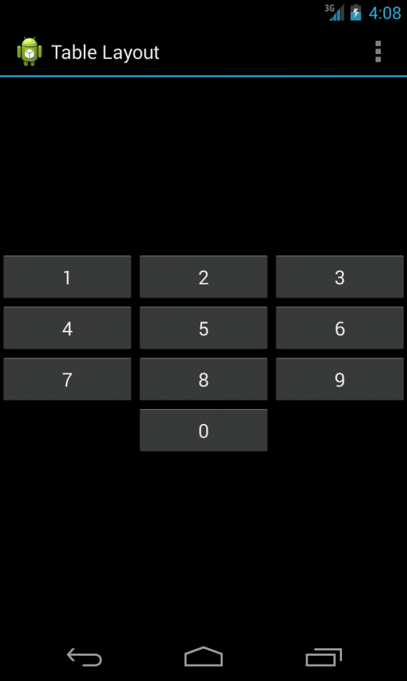
Using TableLayout
Notes:
An example of TableLayout usage.

Slide 35
Using TableLayout
Attribute Name | Applies to | Value
collapseColumns | TableLayout | String or string resource; for example, "0,1,3,5"
shrinkColumns | TableLayout | String or string resource; use “*” for all columns; for example, "0,1,3,5"
stretchColumns | TableLayout | String or string resource; use “*” for all columns; for example, "0,1,3,5"
layout_column | TableRow child View | Integer or integer resource; for example, 1
layout_span | TableRow child View | Integer or integer resource greater than or equal to 1; for example, 3
Notes:
collapseColumns
A comma-delimited list of column indices to collapse (zero based).
shrinkColumns
A comma-delimited list of column indices to shrink (zero based).
stretchColumns
A comma-delimited list of column indices to stretch (zero based).
layout_column
The index of the column this child View should be displayed in (zero based).
layout_span
The number of columns this child View should span across.

Slide 36
Using TableLayout
<TableLayout xmlns:android="http://schemas.android.com/apk/res/android"
android:id="@+id/TableLayout01"
android:layout_width="match_parent"
android:layout_height="match_parent"
android:stretchColumns="*">
<TableRow android:id="@+id/TableRow01">
<Button android:id="@+id/ButtonLeft" android:text="Left Door"/>
<Button android:id="@+id/ButtonMiddle" android:text="Middle Door"/>
<Button android:id="@+id/ButtonRight" android:text="Right Door"/>
</TableRow>
<TableRow android:id="@+id/TableRow02">
<Button
android:id="@+id/ButtonBack"
android:text="Go Back"
android:layout_column="1"/>
</TableRow>
</TableLayout>
Notes:
Here’s an example of an XML layout resource with a TableLayout with two rows (two TableRow child objects). The TableLayout is set to stretch the columns to the size of the screen width. The first TableRow has three columns; each cell has a Button object. The second TableRow puts only one Button control into the second column explicitly.

Slide 37
Using GridLayout
Introduced in Android 4.0 (API Level 14)
The GridLayout organizes its children inside a grid
Don’t confuse it with GridView
  This layout grid is dynamically created
Unlike a TableLayout, child View controls in a GridLayout can span rows and columns and are flatter and more efficient in terms of layout rendering
In fact, it is the child View controls of a GridLayout that tell the layout where they want to be placed
You can find the layout attributes available for GridLayout child View controls in android.widget.GridLayout.LayoutParams

Slide 38
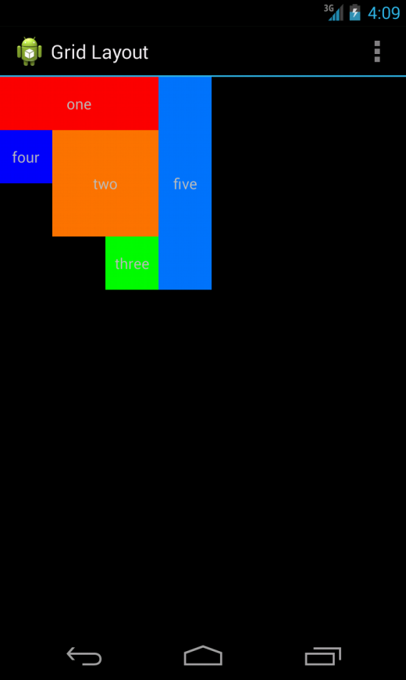
Using GridLayout
Notes:
Here is an example of a GridLayout with five child controls.

Slide 39
Using GridLayout
Attribute Name | Applies to | Value
columnCount | GridLayout | A whole number; e.g., 4
rowCount | GridLayout | A whole number; e.g., 3
orientation | GridLayout | Can be vertical (down a row) or horizontal (over a column)
layout_column | Child View of GridLayout | Integer or integer resource; e.g., 1
layout_columnSpan | Child View of GridLayout | Integer or integer resource greater than or equal to 1; e.g., 3
layout_row | Child View of GridLayout | Integer or integer resource; e.g., 1
layout_rowSpan | Child View of GridLayout | Integer or integer resource greater than or equal to 1; e.g., 3
layout_gravity | Child View of GridLayout | One or more constants separated by “|”; baseline, top, bottom, left, right, and others
Notes:
This table describes some of the important attributes specific to GridLayout controls.

Slide 40
Using GridLayout
  <GridLayout xmlns:android="http://schemas.android.com/apk/res/android"
  android:id="@+id/gridLayout1" android:layout_width="match_parent"
  android:layout_height="match_parent" android:columnCount="4"
  android:rowCount="4" >
  <TextView android:layout_width="150dp" android:layout_height="50dp"
  android:layout_column="0" android:layout_columnSpan="3"
  android:layout_row="0" android:background="#ff0000"
  android:gravity="center" android:text="one" />
  <TextView android:layout_width="100dp" android:layout_height="100dp"
  android:layout_column="1" android:layout_columnSpan="2"
  android:layout_row="1" android:layout_rowSpan="2"
  android:background="#ff7700" android:gravity="center"
  android:text="two" />
  ...
Notes:
The following is an example of an XML layout resource with a GridLayout view resulting in four rows and four columns. Each child control occupies a certain number of rows and columns. Because the default span attribute value is 1, we specify only when the element will take up more than one row or column. For instance, the first TextView is one row high and three columns wide. The height and width of each of the View controls are specified to control the look of the result; otherwise, the GridLayout control will automatically assign sizing.

Slide 41
Using GridLayout
  ...
  <TextView android:layout_width="50dp"
  android:layout_height="50dp"
  android:layout_column="2" android:layout_row="3"
  android:background="#00ff00" android:gravity="center"
  android:text="three" />
  <TextView android:layout_width="50dp"
  android:layout_height="50dp"
  android:layout_column="0" android:layout_row="1"
  android:background="#0000ff" android:gravity="center"
  android:text="four" />
  <TextView android:layout_width="50dp"
  android:layout_height="200dp"
  android:layout_column="3" android:layout_row="0"
  android:layout_rowSpan="4"
  android:background="#0077ff"
  android:gravity="center" android:text="five" />
  </GridLayout>

Slide 42
Using Multiple Layouts on a Screen
Combining different layout methods on a single screen can create complex layouts
Remember that because a layout contains View controls and is, itself, a View control, it can contain other layouts

Slide 43
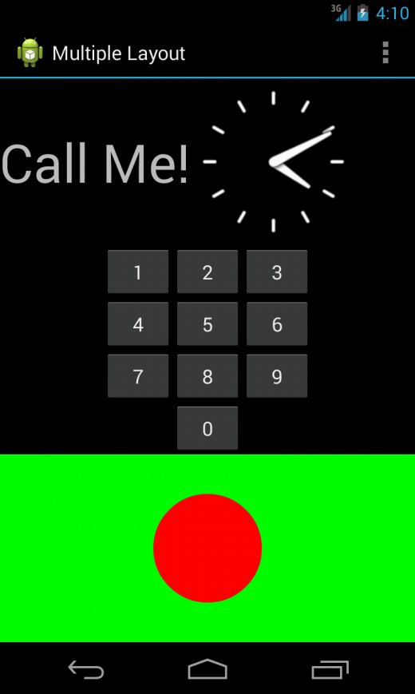
Using Multiple Layouts on a Screen
Notes:
This figure demonstrates a combination of layout views used in conjunction to create a more complex and interesting screen.

Slide 44
Using Container Control Classes
Layouts are not the only controls that can contain other View controls
Although layouts are useful for positioning other View controls on the screen, they aren’t interactive
Now let’s talk about the other kind of ViewGroup, the containers
These View controls encapsulate other, simpler View types and give the user the ability to interactively browse the child View controls in a standard fashion
Much like layouts, each of these controls has a special, well-defined purpose

Slide 45
Using Container Control Classes
The types of ViewGroup containers built into the Android SDK framework include
  Lists and grids
  ScrollView and HorizontalScrollView for scrolling
  ViewFlipper, ImageSwitcher, and TextSwitcher for switching

Slide 46
Using Data-Driven Containers
Some of the View container controls are designed for displaying repetitive View controls in a particular way
Examples are
  ListView
  GridView
These containers are all types of AdapterView controls
An AdapterView control contains a set of child View controls to display data from some data source
An Adapter generates these child View controls from a data source
Notes:
ListView
Contains a vertically scrolling, horizontally filled list of View controls, each of which typically contains a row of data. The user can choose an item to perform some action upon.
GridView
Contains a grid of View controls, with a specific number of columns. This container is often used with image icons. The user can choose an item to perform some action upon.

Slide 47
Using Data-Driven Containers
In the Android SDK, an Adapter reads data from some data source and generates the data for a View control based on some rules, depending on the type of Adapter used
This View is used to populate the child View controls of a particular AdapterView
The most common Adapter classes are the CursorAdapter and the ArrayAdapter
The CursorAdapter gathers data from a Cursor, whereas the ArrayAdapter gathers data from an array
A CursorAdapter is a good choice when using data from a database
An ArrayAdapter is a good choice when there is only a single column of data or when the data comes from a resource array

Slide 48
Using Data-Driven Containers
When creating an Adapter, you provide a layout identifier
This layout is the template for filling in each row of data
The template you create contains identifiers for controls to which the Adapter assigns data
A simple layout can contain as little as a single TextView control
When making an Adapter, refer to both the layout resource and the identifier of the TextView control
The Android SDK provides common layout resources

Slide 49
Using ArrayAdapter
An ArrayAdapter binds each element of the array to a single View control within the layout resource
Here is an example of creating an ArrayAdapter:
    private String[] items = {
    "Item 1", "Item 2", "Item 3" };
    ArrayAdapter adapt =
    new ArrayAdapter<String>
    (this, R.layout.textview, items);
Notes:
In this example, we have a string array called items. This is the array used by the ArrayAdapter as the source data.

Slide 50
Using ArrayAdapter
  <TextView xmlns:android=
  "http://schemas.android.com/apk/res/android"
  android:layout_width="match_parent"
  android:layout_height="wrap_content"
  android:textSize="20sp" />
Notes:
We also use a layout resource, which is the View that is repeated for each item in the array.
This layout resource contains only a single TextView. However, you can use a more complex layout with constructors that also take the resource identifier of a TextView within the layout. Each child View within the AdapterView that uses this Adapter gets one TextView instance with one of the strings from the string array.
If you have an array resource defined, you can also directly set the entries attribute for an AdapterView to the resource identifier of the array to automatically provide the ArrayAdapter.

Slide 51
Using CursorAdapter
A CursorAdapter binds one or more columns of data to one or more View controls within the layout resource provided

Slide 52
Using CursorAdapter
  CursorLoader loader = new CursorLoader(
  this, ContactsContract.CommonDataKinds.Phone.CONTENT_URI,
  null, null, null, null);
  Cursor contacts = loader.loadInBackground();
  ListAdapter adapter = new SimpleCursorAdapter(
  this, R.layout.scratch_layout,
  contacts, new String[] {
  ContactsContract.CommonDataKinds.Phone.DISPLAY_NAME,
  ContactsContract.CommonDataKinds.Phone.NUMBER
  }, new int[] {
  R.id.scratch_text1,
  R.id.scratch_text2
  }, 0);
Notes:
This example demonstrates creating a CursorAdapter by querying the Contacts content provider. The CursorAdapter requires the use of a Cursor.
We present a couple of new concepts. First, you need to know that the Cursor must contain a field named _id. In this case, we know that the ContactsContract content provider does have this field. This field is used later when we handle the user selecting a particular item.
We instantiate a new CursorLoader to get the Cursor. Then we instantiate a SimpleCursorAdapter as a ListAdapter. Our layout, R.layout.scratch_layout, has two TextView controls in it, which are used in the last parameter. SimpleCursorAdapter enables us to match up columns in the database with particular controls in our layout. For each row returned from the query, we get one instance of the layout within our AdapterView.

Slide 53
Binding Data to the AdapterView
Now that you have an Adapter object, you can apply this to one of the AdapterView controls
Either of them will work
Here is an example of this with a ListView, continuing on from the previous sample code:
  ((ListView)findViewById(R.id.scratch_adapter_view))
  .setAdapter(adapter);
Notes:
The call to the setAdapter() method of the AdapterView, a ListView in this case, should come after your call to setContentView(). This is all that is required to bind data to your AdapterView.

Slide 54
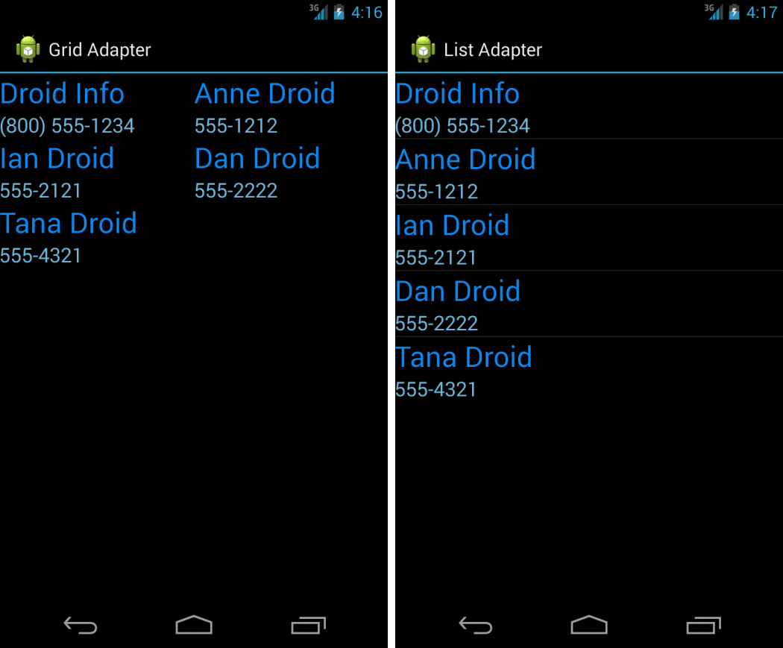
Binding Data to the AdapterView
Notes:
This image shows the same data in a GridView and ListView.

Slide 55
Handling Selection Events
You often use AdapterView controls to present data from which the user should select
Both of the discussed controls—ListView and GridView—enable your application to monitor for click events in the same way
You need to call setOnItemClickListener() on your AdapterView and pass in an implementation of the AdapterView.OnItemClickListener class

Slide 56
Handling Selection Event
av.setOnItemClickListener(
new AdapterView.OnItemClickListener() {
@Override
public void onItemClick(
AdapterView<?> parent, View view,
int position, long id) {
Toast.makeText(Scratch.this, "Clicked _id="+id,
Toast.LENGTH_SHORT).show();
}
});
Notes:
In the preceding example, av is our AdapterView. The implementation of the onItemClick() method is where all the interesting work happens. The parent parameter is the AdapterView where the item was clicked. This is useful if your screen has more than one AdapterView on it. The View parameter is the specific View within the item that was clicked. The position is the zero-based position within the list of items that the user selects. Finally, the id parameter is the value of the _id column for the item that the user selects. This is useful for querying for further information about the row of data that the item represents.
Your application can also listen for long-click events on particular items. Additionally, your application can listen for selected items. Although the parameters are the same, your application receives a call as the highlighted item changes. This can be in response to the user scrolling with the arrow keys and not selecting an item for action.

Slide 57
Using ListActivity
The ListView control is commonly used for full-screen menus or lists of items from which a user selects
Consider using ListActivity as the base class for such screens
Using the ListActivity can simplify these types of screens

Slide 58
Using ListActivity
First, to handle item events, you now need to provide an implementation in your ListActivity
  For instance, the equivalent of onListItemClickListener is to implement the onListItemClick() method within your ListActivity
Second, to assign an Adapter, you need a call to the setListAdapter() method
  You do this after the call to the setContentView() method
  However, this hints at some of the limitations of using ListActivity

Slide 59
Using ListActivity
To use ListActivity, the layout that is set with the setContentView() method must contain a ListView with the identifier set to android:list
  This cannot be changed
Second, you can also have a View with an identifier set to android:empty to have a View display when no data is returned from the Adapter
Finally, this works only with ListView controls, so it has limited use
  However, when it does work for your application, it can save on some coding

Slide 60
Using ListActivity
If you need a two-level list, you should use an ExpandableListActivity
You then use an ExpandableListView for presenting your View data
ExpandableListActivity allows an item within your list to expand and present a sublist of items
To create a sublist of items, you need to create an ExpandableListAdapter to associate with your ExpandableListView

Slide 61
Adding Scrolling Support
One of the easiest ways to provide vertical scrolling for a screen is by using these controls:
  ScrollView (vertical scrolling)
  HorizontalScrollView (horizontal scrolling)
Either control can be used as a wrapper container, causing all child View controls to have one continuous scroll bar
The ScrollView and HorizontalScrollView controls can have only one child, though, so it’s customary to have that child be a layout, such as a LinearLayout, which then contains all the “real” child controls to be scrolled through

Slide 62
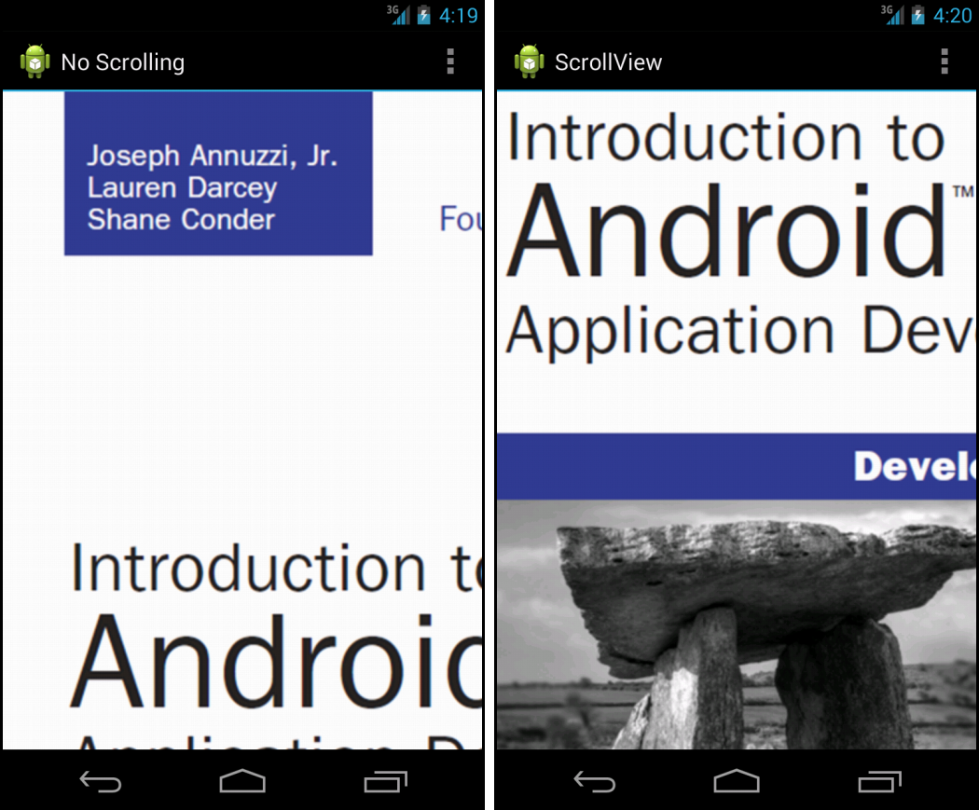
Adding Scrolling Support
Notes:
This figure shows a screen with and without a ScrollView control.

Slide 63
Exploring Other View Containers
Many other user interface controls are available within the Android SDK
Some of these controls are listed here:
  Switchers
  ViewPager
  DrawerLayout
Notes:
Switchers
A ViewSwitcher control contains only two child View controls and only one of those is shown at a time. It switches between the two, animating as it does so. Primarily, the ImageSwitcher and TextSwitcher objects are used. Each one provides a way to set a new child View, either a Drawable resource or a text string, and then animates from what is displayed to the new contents.
ViewPager
A ViewPager is a useful View container for when your application has many different pages of data and you need to support swiping left and right through that data. To use a ViewPager, you must create a PagerAdapter that provides the data for the ViewPager. Fragments are typically used for paging data with ViewPager.
DrawerLayout
A new layout pattern that has been embraced by the Android team is the DrawerLayout. This layout is especially useful for providing a list of navigation items that are hidden off the screen but presented when the user swipes from the left or right, or when he or she presses the Home button from the action bar if the DrawerLayout resides to the left. DrawerLayouts should really only be used for navigation and only when there are more than three top-level views within the application.

